Slide 1

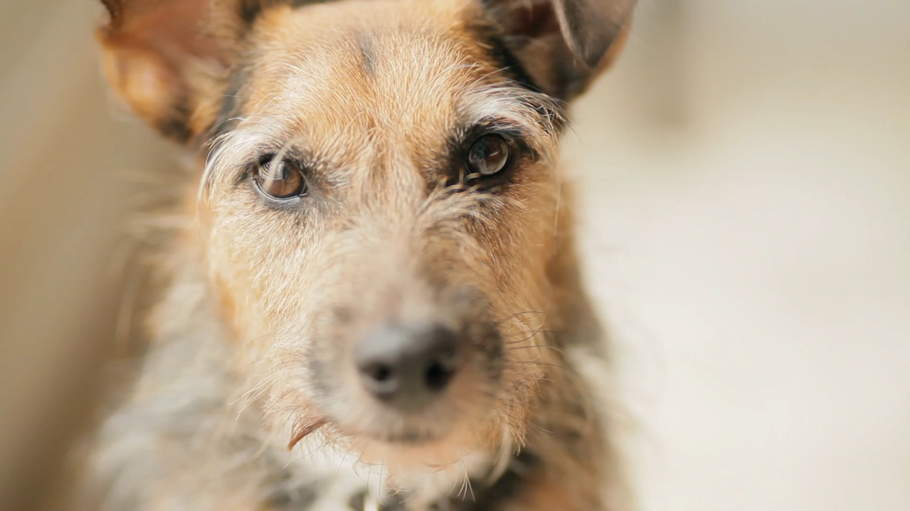
Dogs of Zurich: 2015
All data from Open Data Zurich: https://data.stadt-zuerich.ch/dataset/pd-stapo-hundebestand

Slide 2
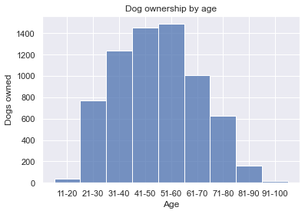
Dog Ownership Peaks from 41-60

Slide 3
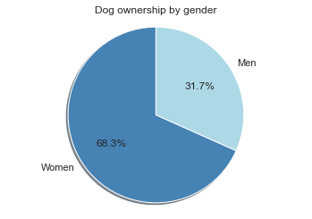
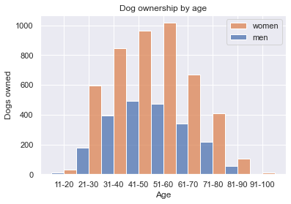
Women Own Twice As Many Dogs
51-60 year-old women own the most dogs in Zurich

Slide 4
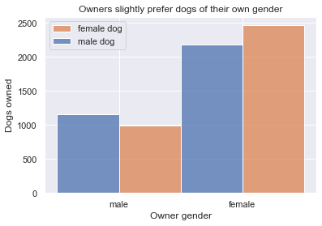
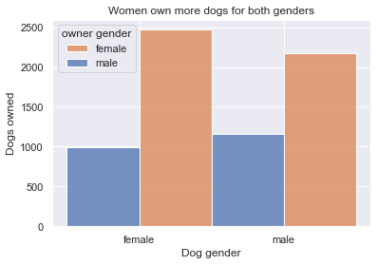
Slight gender bias doesn’t change much

Slide 5
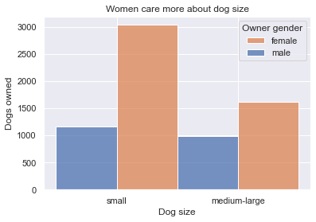
Women want small dogs

Slide 6
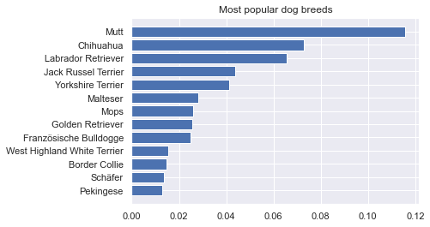
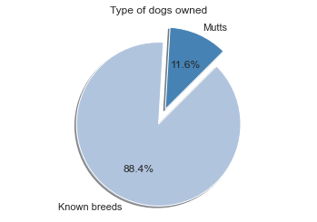
Zurich owned 292 different dog breeds
Top 13 breeds account for 50% of all Zurich dogs
1 in 10 dogs is a mutt

Slide 7
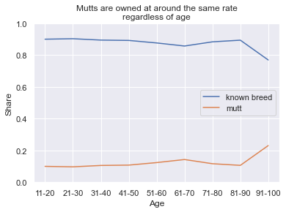
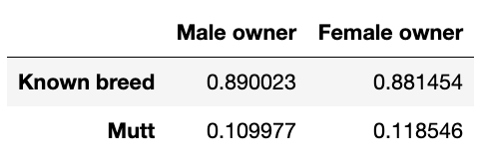
Mutt share does not depend on owner gender or owner age

Slide 8
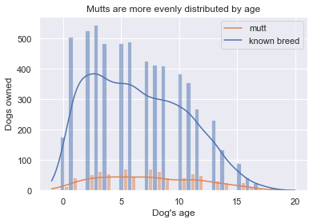
Dogs of known breed tend to be younger, mutts owned equally often at all ages
Does this reflect adoption versus breeding statistics?

Slide 9
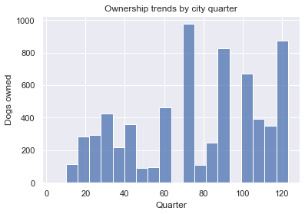
Location’s role remains mysterious
Useful information to collect by city quarter:
Socioeconomic data
Ethnic or racial data
Renting/owning statistics
...and more!

Slide 10
Questions remaining
What about couples/families? Who is the ”owner”?
How do we explain the gender difference?
What about for other pets? How would a cat distribution compare?
Location plays a role within Zurich, what about within Switzerland?

Slide 11
Questions remaining
What about couples/families? Who is the ”owner”?
How do we explain the gender difference?
What about for other pets? How would a cat distribution compare?
Location plays a role within Zurich, what about within Switzerland?

Slide 12
Questions remaining
What about couples/families? Who is the ”owner”?
How do we explain the gender difference?
What about for other pets? How would a cat distribution compare?
Location plays a role within Zurich, what about within Switzerland?

Slide 13
Questions remaining
What about couples/families? Who is the ”owner”?
How do we explain the gender difference?
What about for other pets? How would a cat distribution compare?
Location plays a role within Zurich, what about within Switzerland?

Slide 14
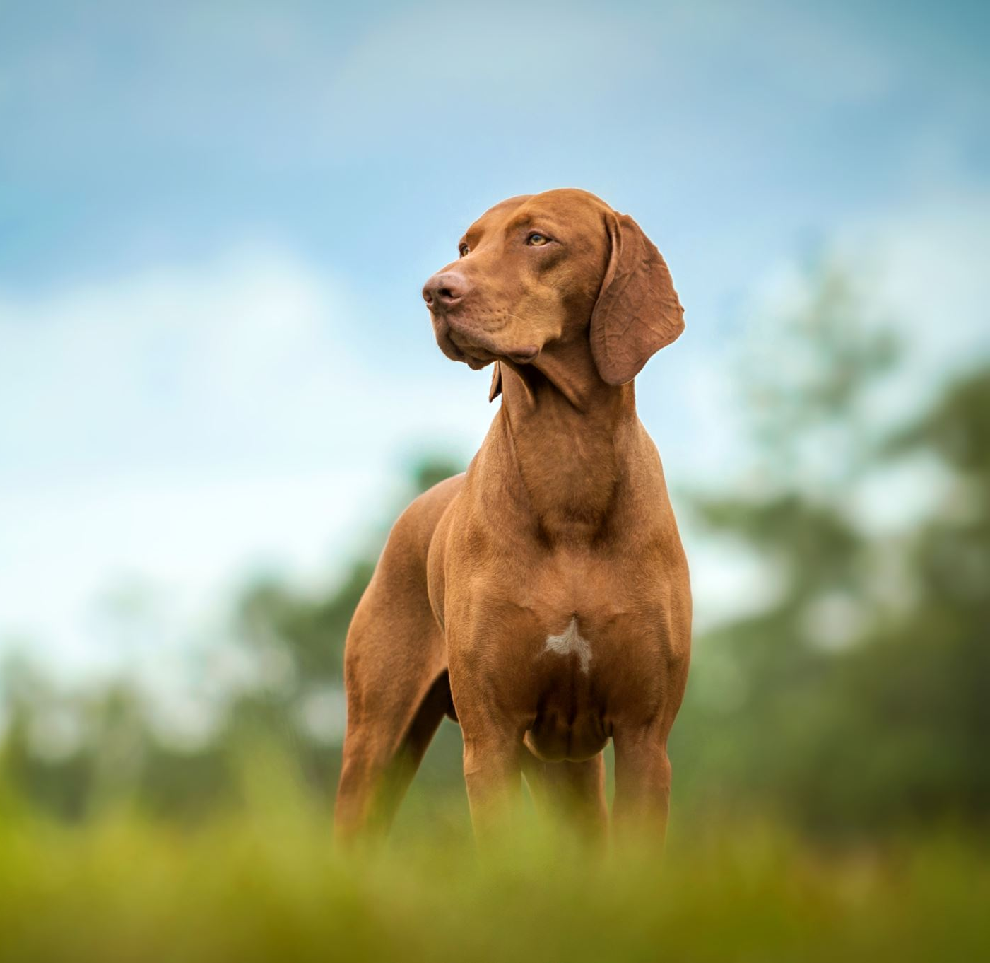
Targeting by dog breeds can be effective
The most popular dozen breeds account for more than half of all dogs from hundreds of breeds
9 out of 10 dogs are identified by their owners by breed

Slide 15
Conclusions
Women own the most dogs and have a stronger size preference
Most people own one of a relatively small number of popular breeds
Owners find breed important
Mutts are evenly distributed across owner ages and genders
More investigation and information is needed to understand the role of location

Slide 16
Conclusions
Women own the most dogs and have a stronger size preference
Most people own one of a relatively small number of popular breeds
Owners find breed important
Mutts are evenly distributed across owner ages and genders
More investigation and information is needed to understand the role of location

Slide 17
Conclusions
Women own the most dogs and have a stronger size preference
Most people own one of a relatively small number of popular breeds
Owners find breed important
Mutts are evenly distributed across owner ages and genders
More investigation and information is needed to understand the role of location

Slide 18
Conclusions
Women own the most dogs and have a stronger size preference
Most people own one of a relatively small number of popular breeds
Owners find breed important
Mutts are evenly distributed across owner ages and genders
More investigation and information is needed to understand the role of location

Slide 19
Conclusions
Women own the most dogs and have a stronger size preference
Most people own one of a relatively small number of popular breeds
Owners find breed important
Mutts are evenly distributed across owner ages and genders
More investigation and information is needed to understand the role of location

